Slide 1




Predicting Mathematics Achievement
60th IEA General Assembly Meeting | October 2019 | Ljubljana, Slovenia
A Machine Learning Approach Using
TIMSS 2015 U.S. National Public-Use Data
Yuqi Liao, Research Associate
Trang Nguyen, Data Scientist
yliao@air.org
@yuqiliao

Slide 2








Introduction
Gender
(McGraw et al., 2006)
Race
(Brown-Jeffy, 2009)
Conventional statistical methods
Educational attainment
(Jordan, 2010)
Poor math
achievement
Family background
(Wang, 2004)
Career advancement
(Geary, 2011)
Teacher qualification
(Darling-Hammond, 2000)
Theory-driven variables
School resources
(Burtless, 2011)

Slide 3

Introduction
Predicting school dropout
(Sansone, 2017)
Finance
Predicting course score
(Polyzou & Karypis, 2016)
Six most common ML algorithms
Health
Business
Social Science Research
Logistic Regression
Only a handful studies applied ML techniques on international large-scale assessment data (Mourshed et al, 2017; Gabriel & Jason Signolet, 2018; Yoo, 2018)
None have compared the performance of different ML methods
Elastic Net
Decision Tree
Random Forest
Extreme Gradient Boosting
Machine Learning (ML)
Neural Network

Slide 4



Introduction
Conventional Statistical Approach
Machine Learning Approach
Conduct literature review
Put theory-driven variables as the input to the regression
Find out the relationship between X and Y
Put all variables as the input to the model
Rank the predictive value of X in predicting Y
Find out the performance of the model in predicting Y
$$\text{β}$$
$$\hat{y}$$
Confirmatory
Exploratory

Slide 5
Methods
TIMSS 2015 US National Public-Use Data
, Grade 8
②
Creating the binary outcome variable [low_mathematics]
Removing irrelevant variables
Removing variables (columns) that have more than 15% missing data
Listwise-deleting observations (rows) that have missing data
Removing variables that are highly correlated with each other
Standardizing variables
0: not low-performing
Achievement data
Student questionnaire data
School questionnaire data
1: low-performing
① Data merging
below the intermediate international benchmark
Merged data (10,221 x 572)
② Data cleaning
 | Var1 | Var2 | Var3 | Var4
Row1 | 1 | 1 | 3 | 1
Row2 | 0 | 2 | NA | 1
Row3 | 1 | 3 | 2 | 1
Row4 | 0 | 1 | 1 | NA
Row5 | 1 | NA | 0 | NA
Row6 | 0 | 1 | 2 | NA
Row7 | 1 | 3 | 1 | NA
Processed data (5,516 x 143)
③ Data splitting
③
 | N | Low-mathematics-achievers | Non-low-mathematics-achievers
Processed Data | 5516 | 1256 | 4260
Training data | 4413 | 1005 | 3408
Test data | 1103 | 251 | 852
Training data
(4,413 x 143)
Test data (1,103 x 143)
⑥ Model evaluation
④ Model training
Model evaluation metrics
Trained ML models
⑥
RQ1: How do the selected machine learning methods compare in predicting low math performers?
⑤ Apply model to test data
⑦ Rank variable by importance
⑦
RQ2: Which variables have the most predictive value in predicting low math performance?
Variable importance

Slide 6


Research Question 1
How do the selected machine learning methods compare in predicting low mathematic performers?

Slide 7
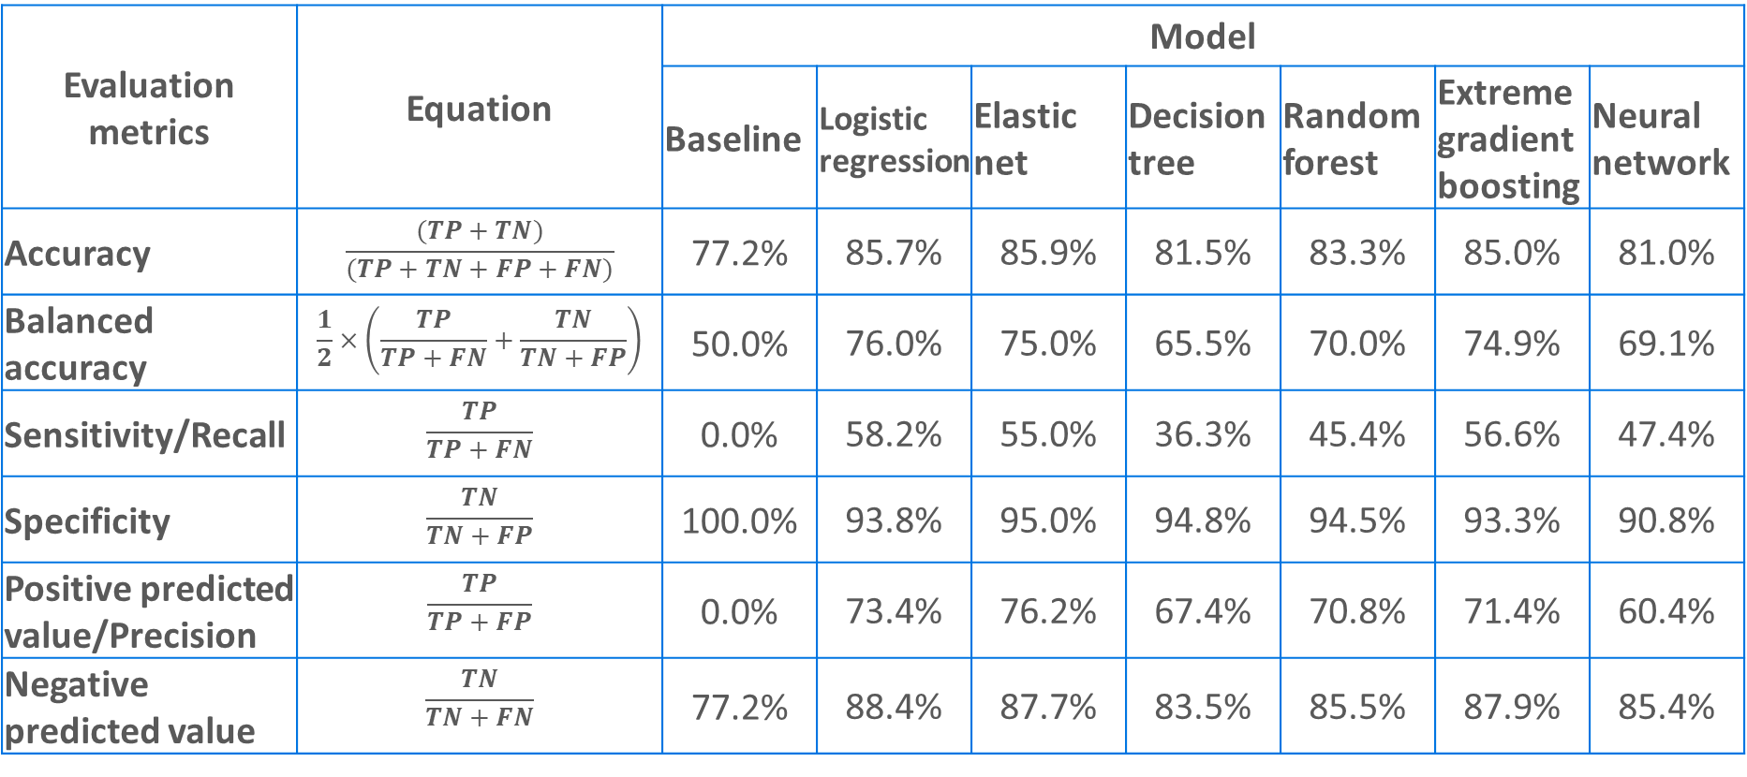
Performance of the selected machine learning models
Evaluation metrics | Equation | Model
 |  | Baseline | Logistic regression | Elastic net | Decision tree | Random forest | Extreme gradient boosting | Neural network
Accuracy | $$\frac{(TP+TN)}{(TP+TN+FP+FN)}$$ | 77.2% | 85.7% | 85.9% | 81.5% | 83.3% | 85.0% | 81.0%
Balanced accuracy | $$\frac{1}{2}×\left(\frac{TP}{TP+FN}+\frac{TN}{TN+FP}\right)$$ | 50.0% | 76.0% | 75.0% | 65.5% | 70.0% | 74.9% | 69.1%
Sensitivity/Recall | $$\frac{TP}{TP+FN}$$ | 0.0% | 58.2% | 55.0% | 36.3% | 45.4% | 56.6% | 47.4%
Specificity | $$\frac{TN}{TN+FP}$$ | 100.0% | 93.8% | 95.0% | 94.8% | 94.5% | 93.3% | 90.8%
Positive predicted value/Precision | $$\frac{TP}{TP+FP}$$ | 0.0% | 73.4% | 76.2% | 67.4% | 70.8% | 71.4% | 60.4%
Negative predicted value | $$\frac{TN}{TN+FN}$$ | 77.2% | 88.4% | 87.7% | 83.5% | 85.5% | 87.9% | 85.4%
True Positive
True Negative
 | N | Low-mathematics-achievers | Non-low-mathematics-achievers
Test data | 1103 | 251 | 852
False Positive
False Negative
TP = number of true positive cases;
TN = number of true negative cases;
FP = number of false positive cases;
FN = number of false negative cases

Slide 8


Research Question 2
Which variables have the most predictive value in predicting low mathematics performance?

Slide 9
Top 20 most important variables, by model
Rank | Decision tree | Random forest | Neural network | Extreme gradient boosting | Elastic net | Logistic regression
1 | pctfrpl | bsbgscm | bsbgscm | bsbgscm | bsbgscm | bsbgscm
2 | bsbgher | bsbgher | bsbgher | bsbgher | bsxg14aYes | bsbgher
3 | msrace2.White..Not.Hispanic | bsbgscs | bcbg04 | bsbgscs | msrace2.AsianYes | bsbg13c
4 | bcbg03a | bsdage | bsng07a.Less.than.high.schoolYes | bcbg10 | msrace2.Black..Not.HispanicYes | bsng08
5 | bsbgscm | pctfrpl | bcdg03 | bcbgeas | msrace2.White..Not.HispanicYes | bcbg16b
6 | bcbg04 | bcbgeas | bcxg21dYes | bsdage | bnrgcal1Yes | bsbg05
7 | bcbgdas | bcbg10 | pctfrpl | msrace2.White..Not.HispanicYes | bsng07a.Less.than.high.schoolYes | bsbs37g
8 | bsng08 | bsng08 | msrace2.AsianYes | pctfrpl | bsng07a.Doctorate..Ph.D...or.Ed.D..Yes | bsbgeml
9 | bcxg06 | bsbgslm | bcbg07a | bsbgeml | bsbgher | bsbgscs
10 | bcbgeas | bcbgdas | msrace2.White..Not.HispanicYes | bsng08 | bcbg22aYes | bsbs25ab
11 | bsbg13c | msrace2.White..Not.HispanicYes | msrace2.Black..Not.HispanicYes | bcbg07b | bcxg20cYes | bsxg14aYes
12 | bsbs26ab | bsbgeml | bcxg20dYes | bcbgdas | bsxg04bYes | bnrgcal2
13 | bcbg07b | bcbg07b | bsdmwkhw | bsbgsvm | bsng07b.Doctorate..Ph.D...or.Ed.D..Yes | bsxg04bYes
14 | bcbg05a | bsbgsvm | bsxg14aYes | bsbgsb | bsbg06bYes | bsbg06bYes
15 | bsdage | bsbgsls | bcbg18b | bsbgslm | bsbg06aYes | bsbg06aYes
16 | bnrgcal1 | bsbgsb | bsxg04aYes | bsbg13c | bsng07a.Some.high.schoolYes | msrace2.AsianYes
17 | bsbs26bb | bcbgsrs | bsng07b.Some.high.schoolYes | bsbgsls | bcxg07.A.magnet.school.or.school.with.a.special.program.emphasisYes | msrace2.White..Not.HispanicYes
18 | bsxg14a | bsbgsvs | bcxg06 | msrace2.Black..Not.HispanicYes | bsbg13c | bnrgcal1Yes
19 | bsdmwkhw | bsbgssb | bcbg03b | bsbgsvs | bsxg04cYes | bsxg04cYes
20 | bsbgeml | bsbgesl | bsbg06bYes | bsbgesl | bsbs37g | bcxg20cYes

Slide 10
Variables selected by at least 3 machine learning models
Variable description | Variable source | Appear in the top 20 most important variables
 |  | Count | Logistic regression | Elastic net | Decision tree | Random forest | Extreme gradient boosting | Neural network
Home Educational Resources Scale | Student | 6 | X | X | X | X | X | X
Students Confident in Mathematics Scale | Student | 6 | X | X | X | X | X | X
[US National Variable] Race/Ethnicity - White, Not Hispanic | Student | 5 | X | X |  | X | X | X
[US National Variable] Percentage of student eligible for free or reduced-price lunch | School | 4 |  |  | X | X | X | X
[US National Variable] How far in your education do you expect to go? | Student | 4 | X |  | X | X | X
How often do you use a computer or tablet for schoolwork besides at home or at school | Student | 4 | X | X | X |  | X
Students' Views on Engaging Teaching in Mathematics Lessons Scale | Student | 4 | X |  | X | X | X
School Discipline Problems - Principals' Reports Scale | School | 3 |  |  | X | X | X
School Emphasis on Academic Success – Principals’ Reports Scale | School | 3 |  |  | X | X | X
Total Instructional Time in Minutes | School | 3 |  |  | X | X | X
Student Age | Student | 3 |  |  | X | X | X
Students Confident in Sciences Scale | Student | 3 | X |  |  | X | X
[US National Variable] Race/Ethnicity - Asian | Student | 3 | X | X |  |  |  | X
[US National Variable] Race/Ethnicity - Black | Student | 3 |  | X |  |  | X | X
[US National Variable] Have you ever repeated a grade in elementary school? | Student | 3 | X | X |  |  |  | X
[US National Variable] Do you have a computer or tablet that is shared with other people at home? | Student | 3 | X | X |  |  |  | X
Home environment support
Students’ attitudes and engagement
Students’
background characteristics
School environment

Slide 11
Conclusion
Compares six commonly used machine learning models in identifying students with low math performance. Logistic regression is preferred in this context (TIMSS 2015 US 8th grade students).
Demonstrates one way that machine learning could be applied to international large-scale studies: as a screening method to test theories and discover new variables
Confirms the findings in the literature about characteristics that may be associated with math performance, including students’ home educational resources and attitudes toward math.
Sheds light on a few variables that receive less research attention, including variables about students’ use and possession of computers or tablets.

Slide 12
References
Allison, P. D. (2001). Missing Data. Thousand Oask, California: Sage Publications.
Brown-Jeffy, S. (2009). School Effects: Examining the Race Gap in Mathematics Achievement. Journal of African American Studies, 388.
Burtless, G. (2011). Does Money Matter? The Effect of School Resources on Student Achievement and Adult Success. Washington DC: Brookings Institution Press.
Chen, T., He, T., Benesty, M., Khotilovich, V., Tang, Y., Cho, H., . . . Li, Y. (2018). xgboost: Extreme Gradient Boosting. R package version 0.71.1.
Darling-Hammond, L. (2000). Teacher Quality and Student Achievement. Education Policy Analysis Archives.
Friedman, J., Hastie, T., & Tibshirani, R. (2010). Regularization Paths for Generalized Linear Models via. Journal of Statistical Software.
Gabriel, F., & Jason Signolet, M. W. (2018). A Machine Learning Approach to Investigating The Effects of Mathematics Dispositions on Mathematical Literacy. International Journal of Research & Method in Education, 306-327.
García, V., Mollineda, R., & Sánchez, J. (2009). Index of Balanced Accuracy: A Performance Measure for Skewed Class Distributions. Pattern Recognition and Image Analysis.
Geary, D. C. (2011). Consequences, Characteristics, and Causes of Mathematical Learning Disabilities and Persistent Low Achievement in Mathematics. Journal of Developmental and Behavioral Pediatrics, 250–263.
Hall, P., Phan, W., & Ambati, S. S. (n.d.). Ideas on Interpreting Machine Learning. Retrieved from O’Reilly Ideas: https://www.oreilly.com/ideas/ideas-on-interpreting-machine-learning
Hastie, T., & Qian, J. (2014). Glmnet Vignette. Retrieved from https://web.stanford.edu/~hastie/glmnet/glmnet_alpha.html
Hastie, T., Tibshirani, R., & Friedman, J. (2001). The Elements of Statistical Learning. New York, NY: Springer Publishing Company.
James, G., Witten, D., Hastie, T., & Tibshirani, R. (2014). An Introduction to Statistical Learning with Applications in R. New York, NY: Springer Publishing Company.
Jordan, N. C. (2010). Early Predictors of Mathematics Achievement and Mathematics Learning Difficulties. Encyclopedia on Early Childhood Development.
Kuhn, M. (2017). caret: Classification and Regression Training. R package version 6.0-78.
Lantz, B. (2013). Machine Learning with R. Birmingham: Packt Publishing.
Liaw, A., & Wiener, M. (2002). Classification and Regression by randomForest. R News, 18-22.
McGraw, R., Lubienski, S. T., & Strutchens, M. E. (2006). A Closer Look at Gender in NAEP Mathematics Achievement and Affect Data: Intersections with Achievement, Race/Ethnicity, and Socioeconomic Status. Journal for Research in Mathematics Education, 129-150.
Mourshed, M., Krawitz, M., & Dorn, E. (2017). How to Improve Student Educational Outcomes: New Insights from Data Analytics. McKinsey & Company.
Mullis, I. V., Martin, M. O., Foy, P., & Hooper, M. (2016). TIMSS 2015 International Results in Mathematics. Boston College.
National Mathematics Advisory Panel. (2008). Foundations for Success: The Final Report of the National Mathematics Advisory Panel. Washington, DC: U.S. Department of Education.
Polyzou, A., & Karypis, G. (2016). Grade Prediction with Course and Student Specific Models. In Advances in Knowledge Discovery and Data Mining (pp. 89-101). Springer.
Provasnik, S., Malley, L., Stephens, M., Landeros, K., Perkins, R., & and Tang, J. (2016). Highlights From TIMSS and TIMSS Advanced 2015: Mathematics and Science Achievement of U.S. Students in Grades 4 and 8 and in Advanced Courses at the End of High School in an International Context. Washington, DC: U.S. Department of Education.
R Core Team. (2013). R: A language and environment for statistical computing. R Foundation for Statistical Computing.
Samuel, A. L. (1959). Some Studies in Machine Learning Using the Game of Checkers. IBM Journal of Research and Development, 210-229.
Sansone, D. (2017). Beyond Early Warning Indicators: High School Dropout and Machine Learning. Social Science Research Network.
Therneau, T., & Atkinson, B. (2018). rpart: Recursive Partitioning and Regression Trees. R package version 4.1-13.
Venables, W. N., & Ripley, B. D. (2002). Modern Applied Statistics with S. Fourth Edition. New York, NY: Springer.
Wang, D. B. (2004). Family background factors and mathematics success: A comparison of Chinese and US students. International Journal of Educational Research, 40-54.
Yoo, J. E. (2018). TIMSS 2011 Student and Teacher Predictors for Mathematics Achievement Explored and Identified via Elastic Net. Frontiers in Psychology, 317.
Zahedifard, M., Attarzadeh, I., Pazhokhzadeh, H., & Malekzadeh, J. (2015). Prediction of students’ performance in high school by data. International Academic Journal of Science and Engineering.
Icons used in the presentation are provided by Noun Project.

Slide 13


Predicting Mathematics Achievement
60th IEA General Assembly Meeting | October 2019 | Ljubljana, Slovenia
A Machine Learning Approach Using
TIMSS 2015 U.S. National Public-Use Data
Thank you
Yuqi Liao
yliao@air.org
@yuqiliao
Trang Nguyen

Slide 14
Limitation/Future studies
Limitations
Missing data imputation
Algorithms may perform differently on other countries’ data
Future studies
ML + assessment data
to provide alternatives to the Rasch model and the PV approach
ML + process data
ML + participation rate prediction
Unsupervised ML to group students with similar traits for better policy recommendation

Slide 15
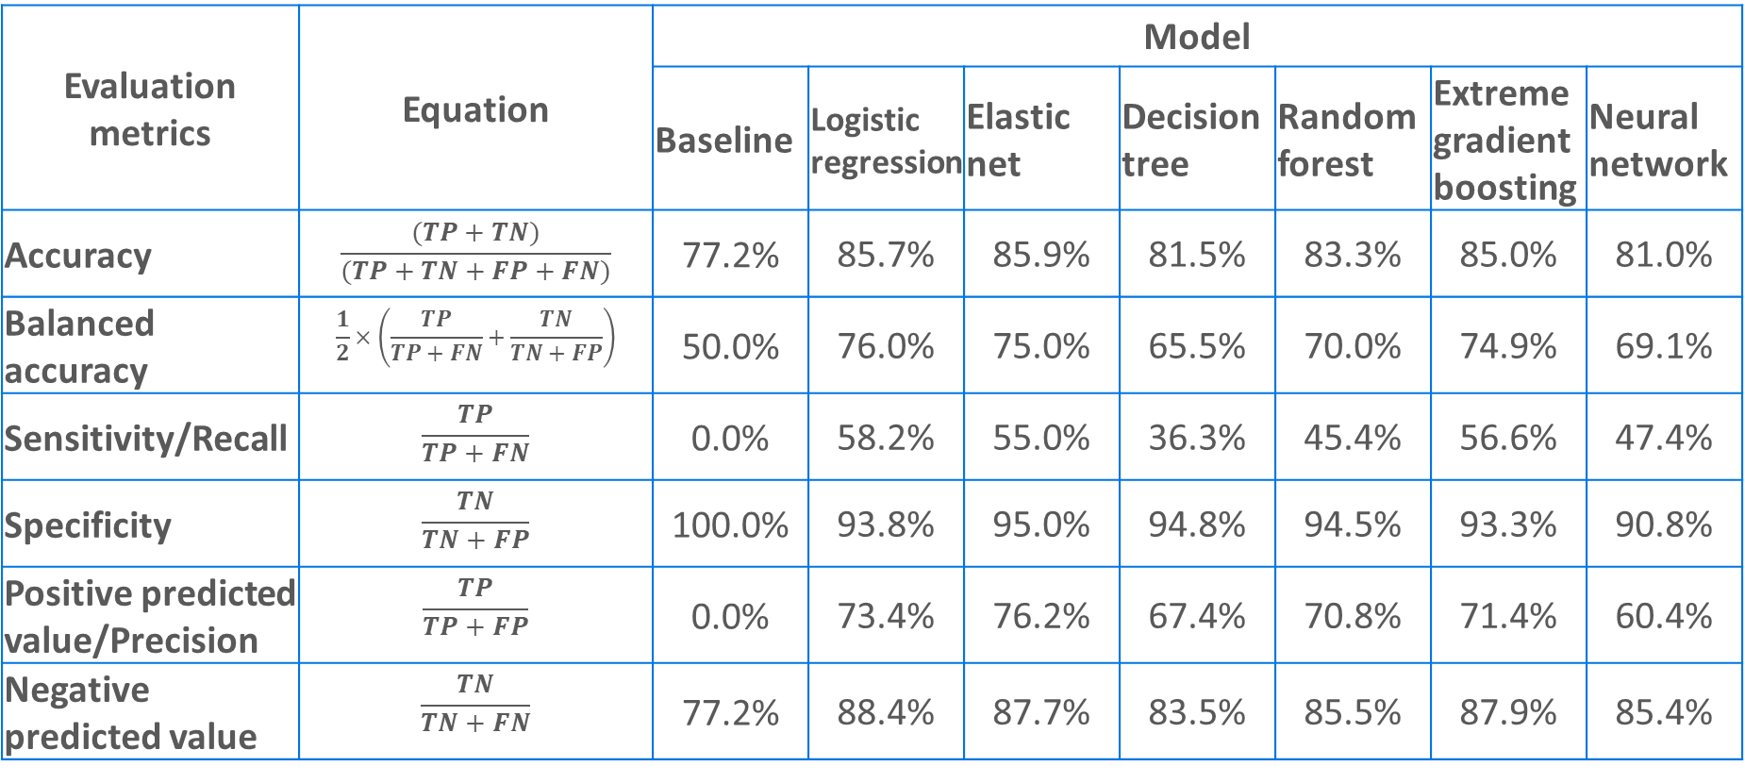
Performance of the selected machine learning models
Evaluation metrics | Equation | Model
 |  | Baseline | Logistic regression | Elastic net | Decision tree | Random forest | Extreme gradient boosting | Neural network
Accuracy | $$\frac{(TP+TN)}{(TP+TN+FP+FN)}$$ | 77.2% | 85.7% | 85.9% | 81.5% | 83.3% | 85.0% | 81.0%
Balanced accuracy | $$\frac{1}{2}×\left(\frac{TP}{TP+FN}+\frac{TN}{TN+FP}\right)$$ | 50.0% | 76.0% | 75.0% | 65.5% | 70.0% | 74.9% | 69.1%
Sensitivity/Recall | $$\frac{TP}{TP+FN}$$ | 0.0% | 58.2% | 55.0% | 36.3% | 45.4% | 56.6% | 47.4%
Specificity | $$\frac{TN}{TN+FP}$$ | 100.0% | 93.8% | 95.0% | 94.8% | 94.5% | 93.3% | 90.8%
Positive predicted value/Precision | $$\frac{TP}{TP+FP}$$ | 0.0% | 73.4% | 76.2% | 67.4% | 70.8% | 71.4% | 60.4%
Negative predicted value | $$\frac{TN}{TN+FN}$$ | 77.2% | 88.4% | 87.7% | 83.5% | 85.5% | 87.9% | 85.4%
True Positive
True Negative
 | N | Low-mathematics-achievers | Non-low-mathematics-achievers
Test data | 1103 | 251 | 852
False Positive
False Negative
TP = number of true positive cases;
TN = number of true negative cases;
FP = number of false positive cases;
FN = number of false negative cases

Slide 16



Analysis tools and resources

Slide 17

Analysis tools and resources
R Package – EdSurvey
https://www.air.org/project/nces-data-r-project-edsurvey

Slide 18
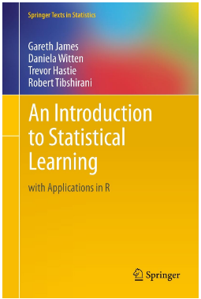
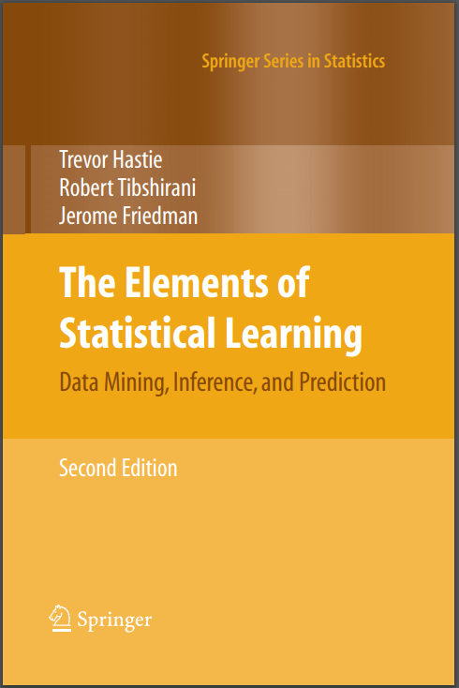


Additional Resources

Slide 19


What is TIMSS?
Representative sample of students
Assessments
Questionnaires
International assessment
Mathematics & science achievement
4th and 8th grade students
First conducted in 1995
Latest cycle is TIMSS 2015
55 education systems participated at the 4th-grade level
44 education system participated at the 8th-grade level

Slide 20
Logistic Regression
Logistic regression is one of the most commonly used ML algorithms for binary classification. A sigmoid function is applied to map the linear regression output to continuous values from 0 to 1, which represent the probability of classification. A threshold classifier of 0.5 is used to convert the probability into either 0 or 1.
The logistic regression model is implemented by the “glm” R package (R Core Team, 2013).

Slide 21
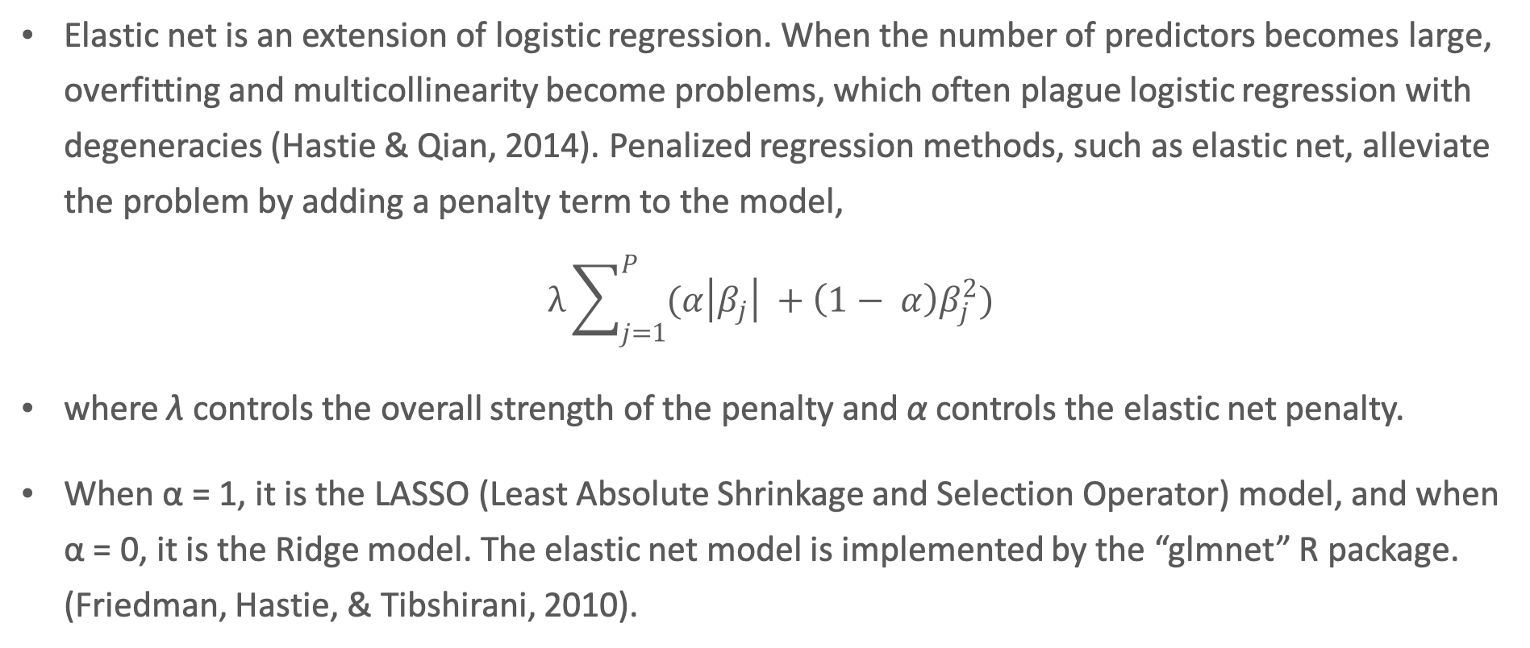
Elastic Net
Elastic net is an extension of logistic regression. When the number of predictors becomes large, overfitting and multicollinearity become problems, which often plague logistic regression with degeneracies (Hastie & Qian, 2014). Penalized regression methods, such as elastic net, alleviate the problem by adding a penalty term to the model,
$$λ\sum_{j=1}^{P}{(α\left|β_{j}\right| +\left(1− α\right)β_{j}^{2})}$$
where λ controls the overall strength of the penalty and α controls the elastic net penalty.
When α = 1, it is the LASSO (Least Absolute Shrinkage and Selection Operator) model, and when α = 0, it is the Ridge model. The elastic net model is implemented by the “glmnet” R package. (Friedman, Hastie, & Tibshirani, 2010).

Slide 22
Decision Tree
The decision tree model is one of the tree-based methods, which involve splitting the dataset recursively. At each step, the split is made based on the independent variable that results in the largest possible reduction in heterogeneity of the dependent variable.
Splitting a dataset recursively means that the subsets that arise from a split are further split until a predetermined termination criterion is reached.
The decision tree model is implemented by the “rpart” R package (Therneau & Atkinson, 2018).

Slide 23
Random Forest
Random forest is an extension of the decision tree model. It involves producing and combining multiple trees (hence “forest”) to yield a single consensus prediction.
It is known that combining a large number of trees can often result in dramatic improvements in prediction accuracy, at the expense of some loss in interpretation. The random forest model is implemented by the “randomForest” R package (Liaw & Wiener, 2002).

Slide 24
Extreme Gradient Boosting
Extreme gradient boosting, like random forest, uses an ensemble of multiple trees to create a more powerful prediction model. Unlike random forest, which builds and combines a forest of randomly different trees in parallel, extreme gradient boosting builds a series of trees in such a way that when each tree is trained, it attempts to correct the mistakes, or misclassification, of the previous tree in the series. The final prediction is based on the aggregate results of all trees in the series. The model also reduces the risk of overfitting by heavily penalizing complexity.
The extreme gradient boosting model is implemented by the “xgboost” R package (Chen, et al., 2018).

Slide 25
Neural Network
Neural network models are inspired by the way biological neural networks in the human brain process information. A simple form of neural network is called multi-layer perceptron, which has three components: an input layer, one or many hidden layer(s), and an output layer.
A single hidden layer neural network model is implemented by the “nnet” R package (Venables & Ripley, 2002).

Slide 26
TIMSS International Benchmarks
TIMSS defines four levels of student achievement, referred to as international benchmarks: Advanced, High, Intermediate, and Low. These international benchmarks provide a way to understand how students’ proficiency in mathematics varies at different points on the TIMSS scale.
Grade 8 students who perform below 400 are considered below the low international mathematics benchmark. Grade 8 students who perform at or above 400 but below 475 are considered to be at the low international mathematics benchmark (Mullis, Martin, Foy, & Hooper, 2016)

Slide 27
Appendix A – Technical Details in Data Preprocessing
The data cleaning process involved the following steps:
Create the binary outcome variable, [low_mathematics], which equals 1 if the student is considered low performing in mathematics (and 0 otherwise), defined as having the average of all 5 plausible values for mathematics below the intermediate international benchmark (475).
Remove ID-related variables (e.g., [idstud] – student ID), file maintenances variables (e.g., [itdate] – date of testing), weights (e.g., [totwgt] – total student weight), plausible values (e.g., [bsmmat01] – the first plausible value of mathematics), and string variables (e.g. [bsxg03bt] – the U.S.-specific variable about language spoken at home, which is in strings)
For a few U.S.-specific variables, remove the international version of such variables because the U.S. versions provide more granular information. For example, for the background question, “how far in education do you expect to go,” the U.S. version ([bsng08]) distinguishes between “finish master’s degree” and “finish doctorate degree,” while the international version ([bsbg08]) only has “finish postgraduate degree.”
For all derived scale variables (e.g., [bsbgscm] – “Student Confident in Mathematics/SCL”), remove their index versions (e.g., [bsdgscm] – “Student Confident in Mathematics/IDX”), and remove the questionnaire-level variables that these scale variables are derived from (e.g., from [bsbm19a] - “I usually do well in mathematics” to [bsbm19i] – “mathematics makes me confused”)
Remove variables that have more than 15% missing. (Variable levels such as “Not administered” and “Omitted or invalid” are counted as missing.) The threshold of 15% is chosen to maintain at least half of the original samples after list-wise deletion, which is considered the safest method of handling missing data (Allison, 2001). Increasing the threshold will lead to a smaller sample size after list-wise deletion, while decreasing it will lead to a smaller number of predictors.(In robustness tests where 10% and 20% were used as thresholds, respectively, the findings are consistent with what is documented in the Results and Discussion section.)
Dummy-code all binary variables. Convert Liker scale variables (e.g., [bsbg08]) to continuous. For non-ordinal variables (e.g., [msrace2] – race/ethnicity), dummy code each variable level and remove the last level (e.g., the newly coded [msrace2_other]).
Construct a correlation matrix among all remaining variables to identify variable pairs that are highly correlated (> 0.95) with each other and remove the variable with the largest mean absolution correlation (e.g., [bcbg07b] “total instructional time/minutes” is highly correlated with [bcdg07hy] – “total instructional hours per year,” and the latter is removed).
Standardize all variables so that they are on the same scale with a mean of 0 and standard deviation of 1 (Lantz, 2013).
This data cleaning process resulted in 5,516 grade 8 students (54% of the original sample) with 143 student and school variables.

Slide 28
Appendix B – Variables used in machine learning models
 | Variable Name | Variable Label
1 | low_mathematics | outcome variable: low-mathematics-achiever
2 | bnrgcal1 | calculator survey\use of calculator
3 | bsbg06a | gen\home possess\computer tablet own
4 | bsbg06b | gen\home possess\computer tablet shared
5 | bsbg06c | gen\home possess\study desk
6 | bsbg06d | gen\home possess\own room
7 | bsbg06e | gen\home possess\internet connection
8 | bsbg06f | gen\home possess\own mobile phone
9 | bsbg06g | gen\home possess\gaming system
10 | bsbg06h | gen\home possess\<country specific>
11 | bsbg10a | gen\born in <country>
12 | bsbg14a | gen\internet use\access textbooks
13 | bsbg14b | gen\internet use\access assignments
14 | bsbg14c | gen\internet use\collaborate with classmates
15 | bsbg14d | gen\internet use\communicate with teacher
16 | bsbg14e | gen\internet use\find info to aid in math
17 | bsbg14f | gen\internet use\find info to aid in science
18 | bcbg08a | gen\have place for schoolwork
19 | bcbg09a | gen\student achievement used to assign\math
20 | bcbg09b | gen\student achievement used to assign\science
21 | bcbg11a | gen\existing science laboratory
22 | bcbg11b | gen\existing assistance during exp
23 | bcbg12 | gen\have school library
24 | bcbg17a | gen\use incentives\math
25 | bcbg17b | gen\use incentives\science
 | Variable Name | Variable Label
26 | bcbg17c | gen\use incentives\other
27 | bcbg22a | gen\degrees in education leadership\isced 7
28 | bcbg22b | gen\degrees in education leadership\isced 8
29 | bnrgcal2 | calculator survey\frequency of using calculator
30 | bsbg03 | gen\often speak <lang of test> at home
31 | bsbg05 | gen\digital information devices
32 | bsbg11 | gen\about how often absent from school
33 | bsbg12 | gen\how often breakfast on school days
34 | bsbg13a | gen\how often use computer tablet\home
35 | bsbg13b | gen\how often use computer tablet\school
36 | bsbg13c | gen\how often use computer tablet\other
37 | bsbs25ab | sci\how often teacher give you homework/science
38 | bsbm25ba | math\how many minutes spent on homework/mathematics
39 | bsbm26aa | math\extra lessons last 12 month\mathematics
40 | bsbs26ab | sci\extra lessons last 12 month\science
41 | bsbm26ba | math\extra lessons how many month\mathematics
42 | bsbs26bb | sci\extra lessons how many month\science
43 | bsbs37a | sci\agree\learn science will help me
44 | bsbs37b | sci\agree\need science to learn other things
45 | bsbs37c | sci\agree\need science to get into <uni>
46 | bsbs37d | sci\agree\need science to get job i want
47 | bsbs37e | sci\agree\like job involving science
48 | bsbs37f | sci\agree\get ahead in the world
49 | bsbs37g | sci\agree\more job opportunities
50 | bsbs37h | sci\agree\parents think science important
 | Variable Name | Variable Label
51 | bsbs37i | sci\agree\important to do well in science class
52 | bsbm38aa | math\how often tch give you hmwk\mat
53 | bsdmwkhw | weekly time spent on math homework
54 | bsdswkhs | weekly time spent on science homework
55 | bcbg03a | gen\students background\economic disadva
56 | bcbg03b | gen\students background\economic affluen
57 | bcbg04 | gen\percent of students <lang of test>
58 | bcbg05a | gen\how many people live in area
59 | bcbg05b | gen\immediate area of sch location
60 | bcbg06a | gen\free meals\breakfast
61 | bcbg06b | gen\free meals\lunch
62 | bcbg07c | gen\instructional days in 1 calender week
63 | bcbg16a | gen\fill teaching vacancies\math
64 | bcbg16b | gen\fill teaching vacancies\science
65 | bcbg16c | gen\fill teaching vacancies\other
66 | bcbg18a | gen\degree probs teach\arriving late at school
67 | bcbg18b | gen\degree probs teach\absenteeism
68 | bcbg21 | gen\highest level of formal education
69 | bcdg03 | school composition by std background
70 | bcbg07a | gen\instructional days per year
71 | bcbg07b | gen\total instructional time\minutes
72 | bcbg10 | gen\total number computers
73 | bcbg19 | gen\years principal altogether
74 | bcbg20 | gen\years principal at this school
75 | itsex | sex of students

Slide 29
Appendix B – Variables used in machine learning models
 | Variable Name | Variable Label
76 | bsdage | students age
77 | bsbgher | home educational resources/scl
78 | bsbgssb | students sense of school belonging/scl
79 | bsbgsb | student bullying/scl
80 | bsbgslm | students like learning mathematics/scl
81 | bsbgeml | engaging teaching in math lessons/scl
82 | bsbgscm | student confident in mathematics/scl
83 | bsbgsvm | students value mathematics/scl
84 | bsbgsls | students like learning science/scl
85 | bsbgesl | engaging teaching in science lessons/scl
86 | bsbgscs | student confident in sciences/scl
87 | bsbgsvs | students value science/scl
88 | bcbgsrs | instr aff by sci res shortage-prncpl/scl
89 | bcbgeas | school emph on acad success-prncpl/scl
90 | bcbgdas | school discipline problems-prncpl/scl
91 | bsng07a.Less.than.high.school | nat\derived\highest lvl edu\mother
92 | bsng07a.Some.high.school | nat\derived\highest lvl edu\mother
93 | bsng07a.High.school.graduate | nat\derived\highest lvl edu\mother
94 | bsng07a.Associate.s.degree..2.year.college.program. | nat\derived\highest lvl edu\mother
95 | bsng07a.Bachelor.s.degree..4.year.college.program. | nat\derived\highest lvl edu\mother
96 | bsng07a.Master.s.degree.or.professional.degree..MD..DDS..lawyer..minister. | nat\derived\highest lvl edu\mother
97 | bsng07a.Doctorate..Ph.D...or.Ed.D.. | nat\derived\highest lvl edu\mother
98 | bsng07b.Less.than.high.school | nat\derived\highest lvl edu\father
99 | bsng07b.Some.high.school | nat\derived\highest lvl edu\father
100 | bsng07b.High.school.graduate | nat\derived\highest lvl edu\father
 | Variable Name | Variable Label
101 | bsng07b.Associate.s.degree..2.year.college.program. | nat\derived\highest lvl edu\father
102 | bsng07b.Bachelor.s.degree..4.year.college.program. | nat\derived\highest lvl edu\father
103 | bsng07b.Master.s.degree.or.professional.degree..MD..DDS..lawyer..minister. | nat\derived\highest lvl edu\father
104 | bsng07b.Doctorate..Ph.D...or.Ed.D.. | nat\derived\highest lvl edu\father
105 | bsbg09a.YES | gen\mother born in the us
106 | bsbg09a.NO | gen\mother born in the us
107 | bsbg09b.YES | gen\father born in the us
108 | bsbg09b.NO | gen\father born in the us
109 | msrace2.White..Not.Hispanic | *nat\derived race-collapsed*
110 | msrace2.Black..Not.Hispanic | *nat\derived race-collapsed*
111 | msrace2.Hispanic | *nat\derived race-collapsed*
112 | msrace2.Asian | *nat\derived race-collapsed*
113 | msrace2.Two.or.more.races | *nat\derived race-collapsed*
114 | bcxg07.Regular.public.school | nat\type of school
115 | bcxg07.A.regular.public.school.with.a.magnet.program | nat\type of school
116 | bcxg07.A.magnet.school.or.school.with.a.special.program.emphasis | nat\type of school
117 | bcxg07.Charter.school | nat\type of school
118 | bcxg07.Private..independent. | nat\type of school
119 | bcxg07.Private..religiously.affiliated. | nat\type of school
120 | bsxg04a | nat\activ outside school\sports team
121 | bsxg04b | nat\activ outside school\music instrumnt
122 | bsxg04c | nat\activ outside school\other class
123 | bsxg04d | nat\activ outside school\club
124 | bsxg05a | nat\participated in activ\science fair
125 | bsxg05b | nat\participated in activ\science club
 | Variable Name | Variable Label
126 | bsxg05c | nat\participated in activ\science comp
127 | bsxg14a | nat\repeat grade\elementary
128 | bsxg14b | nat\repeat grade\middle
129 | bcxg20b | nat\teacher eval\math\oberv by external persons
130 | bcxg20c | nat\teacher eval\math\student achieve
131 | bcxg20d | nat\teacher eval\math\teacher peer review
132 | bcxg21b | nat\teacher eval\science\oberv by external persons
133 | bcxg21c | nat\teacher eval\science\student achieve
134 | bcxg21d | nat\teacher eval\science\teacher peer review
135 | bsng08 | nat\derived\how far educ
136 | bsxg13b | nat\days absent last month
137 | bsxg30 | nat\diff test compared oth tests
138 | bsxg31 | nat\how hard tried compared oth tests
139 | bsxg32 | nat\how important to do well
140 | bcxg06 | nat\percent of students lep/ell
141 | bcxg09 | nat\avg income lvl of sch immediate area
142 | pctfrpl | *nat\percent stud free reduce lunch-categorized*
143 | pubpriv | *nat\public private school indicator*

Slide 30
Code
https://github.com/yuqiliao/InternationalAssessment_MachineLearning/blob/master/Code/ML.R

Slide 31
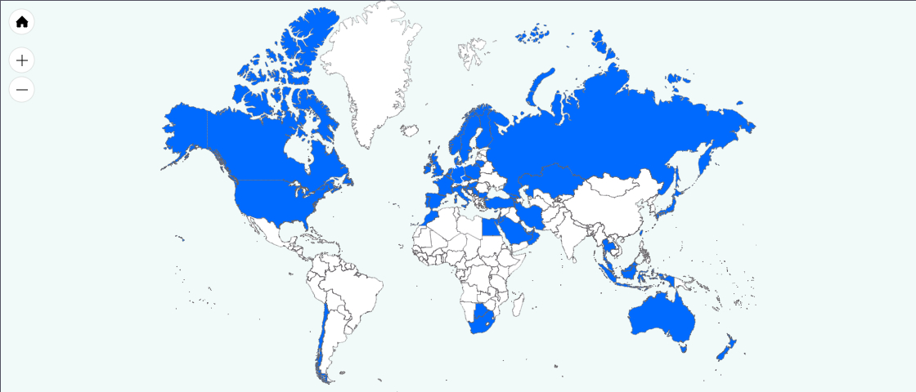
Trends in International Mathematics and Science Study (TIMSS) 2015
Participation at 4th- grade
55 education systems
More than 310,000 students
Participation at 8th- grade
44 education systems
More than 260,000 students
NOTE: Education systems that administered TIMSS at a grade other than the target grade are not included in the count of education systems.
Notes:
Results for Armenia, which did participate in TIMSS 2015 at grades 4 and 8, are not shown because their data are not comparable for trend analysis.

